Slide 1

Participatory Modeling for Societal Complexity in Healthcare
Background and motivation
By Heider Jeffer
Explore our project and Visit our lab

Slide 2
Research Proposal: Participatory Modeling for Societal Complexity in Healthcare
Try It Out: Experiment with our simulation through this interactive Google Colab notebook.
Hello and welcome! We're excited to share our work on participatory modeling for societal complexity in healthcare. Explore and engage with our resources below:
Discover Our Project: Learn about our approach and research on GitHub
Try It Out: Experiment with our simulation through this interactive Google Colab notebook.
Explore the Code: Dive into the details of our simulation by reviewing the source code.
We’d love for you to explore, experiment, and share your thoughts with us!

Slide 3
Presentation Structure
Part 1: My Background and how it relates to this KTH’s PhD position?
Part 2: What motivates me to pursue this position specifically?
Part 3: How would My technical skill contribute to the research goals of this project?
Part 4: Project where I used participatory modeling or similar techniques “KTH PhD project, Developed using Python by Heider Jeffer to answer (Research Questions)”?
Part 5: What do I hope to learn from working within the InSilicoHealth Doctoral Network and at KTH?
Part 6: I have Questions
Part 7: Appendix: Numerical Example, Simulation Steps

Slide 4
Part 1: My Background and how it relates to this KTH’s PhD position?
Interdisciplinary academic background
Master’s thesis

Slide 5
1. Interdisciplinary academic background
Having completed degrees in Physics and Operations Research, followed by advanced studies in Computer Science and Artificial Intelligence.
My experience at USI, ETH Zürich and the Free University of Bozen-Bolzano (UNIBZ) involved hands-on projects and laboratory focused on participatory Modulation Simulation Optimization, Human Machine Interaction, software reliability and testing, Stochastic process and system dynamics—areas I believe are highly relevant to this position.

Slide 6
2. Master’s thesis
I explored the failure factors of the “Elizabeth Anne Holmes the American biotechnology entrepreneur the founder of Theranos as an exemplar case study for my research, specifically addressing the regulatory and legal challenges that contributed to its downfall. Using gray literature”.
I developed a model for both qualitative and quantitative data collection and analysis. This approach allowed me to identify key factors related to the healthcare sector’s challenges. Through this work, I further developed my technical expertise in Python, data analysis, and complex model building—skills I am eager to apply in the PhD role at KTH.

Slide 7
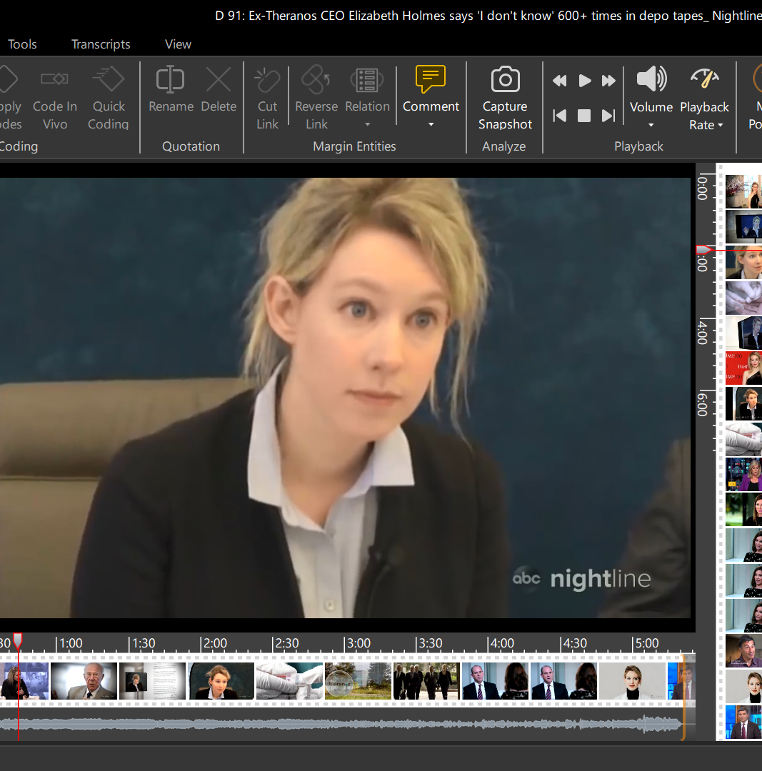
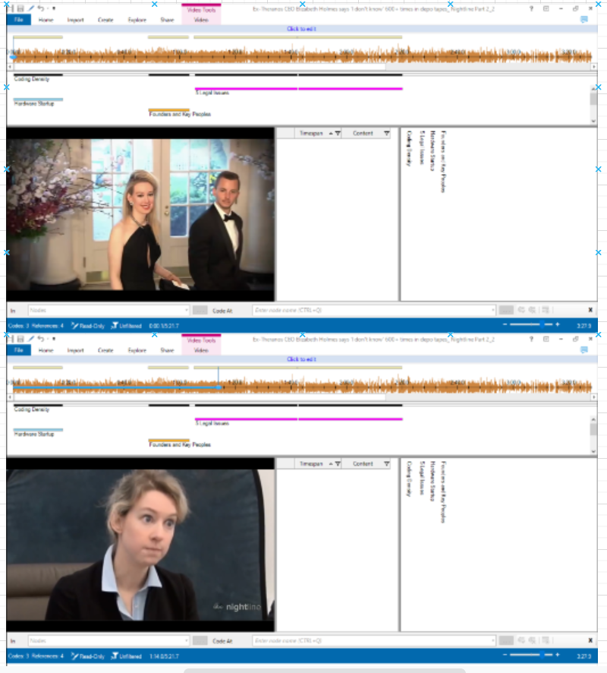

Slide 8
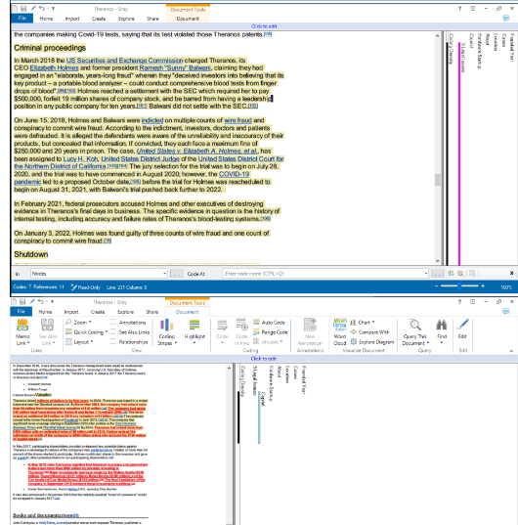
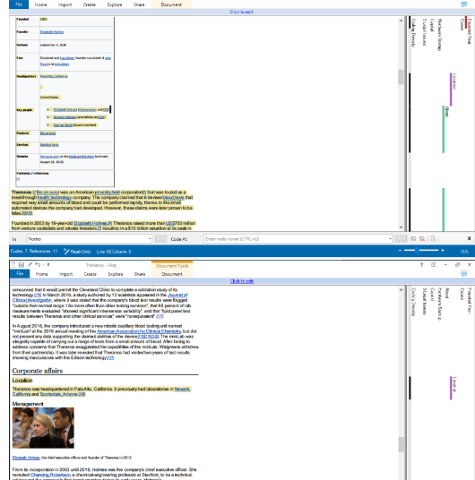

Slide 9
Part 2: What motivates me to pursue this position specifically?
The escalating challenges in global healthcare
Driving Impact
Passion for Real-World Impact

Slide 10
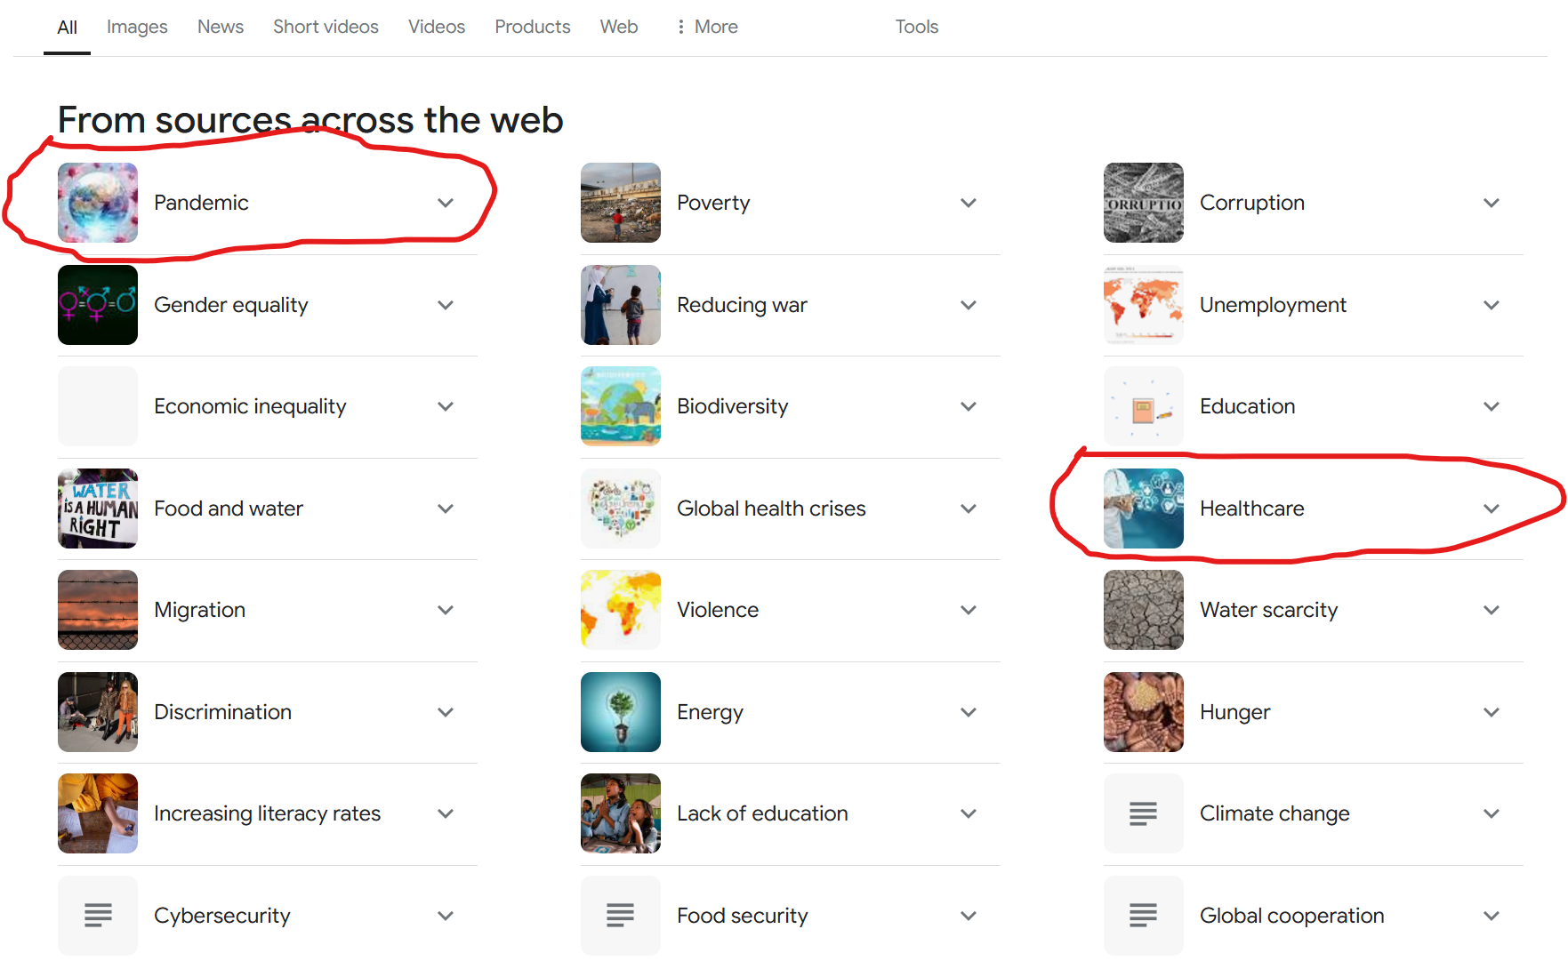
1. The escalating challenges in global healthcare

Slide 11
1. The escalating challenges in global healthcare
Global healthcare challenges—pandemics like COVID-19, antimicrobial resistance, unequal healthcare access, and rising health issues—are urgent and demand innovative solutions.
The escalating challenges in global healthcare are hot topics that require immediate action, and we must start as soon as humanly possible.
I am motivated to address these crises through KTH’s platform, leveraging its leadership in research, technology, and collaboration to drive impactful solutions.
KTH’s expertise uniquely positions it to lead efforts in healthcare accessibility, health systems innovation, and health support in local, European and international level.
Aligning my skills with KTH’s mission, I aim to help tackle these pressing issues and build resilience against future global health challenges.

Slide 12
2. Driving Impact
Advancing In Silico Models to Transform Decision-Making in Healthcare
What excites me most about this position is the chance to work on the societal complexities surrounding in silico models in healthcare.
I see enormous potential in developing models that help stakeholders—such as healthcare providers and administrators—make informed decisions that benefit patients.

Slide 13
3. Passion for Real-World Impact
Leveraging Expertise in Design and Optimization to Contribute to KTH's Vision.
My past projects on designing, modulation, simulation and optimization has fueled my interest in impactful, real-world applications, which aligns well with KTH’s vision.
I believe my motivation, combined with a practical approach, would enable me to contribute significantly to this PhD project and make a meaningful impact.

Slide 14
Part 3: How would My technical skill contribute to the research goals of this project?
Technical skills
Experience

Slide 15
1. Technical skills
My technical skills span a variety of areas relevant to this project.
I am proficient in Python, Java, and other languages for modeling and simulation, which aligns well with the participatory modeling and complexity analyses required in this PhD project.

Slide 16
2. Experience
Experience with statistical methods and data visualization will support the rigorous analysis needed to validate and communicate findings effectively.

Slide 17
Part 4: Project where I used participatory modeling or similar techniques
In this KTH PhD project. The Python code I developed for the KTH Project simulates stakeholder interactions and contributions within a participatory modeling framework, providing answers to the (Research Questions) explored in this project:
Primary Research Question:
How can participatory modeling approaches be designed to simulate and address stakeholder interactions, agency complexities, and decision-making processes in the adoption of in silico models for healthcare systems?
Secondary Research Questions:
How can simulation techniques be used to capture and analyze the interplay of diverse stakeholders in the healthcare ecosystem?
The code models the interactions and contributions of different stakeholders, providing a quantitative and qualitative analysis of their roles in decision-making processes.

Slide 18
Part 5: What do I hope to learn from working within the InSilicoHealth Doctoral Network and at KTH?
Exploring KTH’s Approach
Real-World Healthcare Insights
Gaining a Holistic Understanding of Healthcare Challenges

Slide 19
1. Exploring KTH’s Approach
To learn about KTH’s approach to integrating participatory modeling within healthcare systems and to understand the nuances of translating model outputs into practical strategies that can be implemented in hospitals

Slide 20
2. Real-World Healthcare Insights
The secondments in Amsterdam and Karolinska University Hospital are also particularly exciting to me, as they offer a chance to experience firsthand how models are applied in real-world healthcare settings.

Slide 21
3. Gaining a Holistic Understanding of Healthcare Challenges
Allowing me to develop solutions that support evidence-based policy and management decisions in healthcare

Slide 22
Part 6: Questions
Could you share more about the specific goals the research group hopes to achieve with this project?
How does KTH facilitate collaboration between doctoral candidates within the InSilicoHealth network?
What qualities or skills have you found most beneficial for success in this doctoral program?
Could you explain more about the participatory model approaches used in this project?

Slide 23
Part 7: Appendix
A: Healthcare Participatory Model Simulation
B: Statistical Distribution and Visualization
1. Random Fluctuations and Why They Are Used
2. Uptake Rate and Why It Is Used
3. Feedback Loop and Why It Is Used
4. Visualizing Trends and Why It Is Important
5. Why Combine These Elements?
6. Numerical Example, Simulation Steps

Slide 24
The engagement level is simulated for different groups
Patients: How involved patients are in a healthcare system, project, or study.
Doctors: The degree of participation or involvement of doctors in a healthcare setting or initiative.
Nurses: The level of engagement of nursing staff in activities, events, or initiatives.
Administrators: The level of involvement of administrative personnel in decision-making, planning, or day-to-day operations.

Slide 25
A: Healthcare Participatory Model Simulation
I have developed a Python-based code that simulates a simplified healthcare participatory model. This model collects, processes, and visualizes opinions from various healthcare stakeholders (patients, doctors, administrators).
The simulation demonstrates key processes such as data collection, stakeholder engagement, and system dynamics analysis—skills highly relevant to the Doctoral project.
The modular design of this code not only reflects my expertise in Python and data processing, but also demonstrates a deep understanding of participatory modeling, system dynamics, and stakeholder interactions within healthcare settings.
This code is adaptable, allowing for future refinement and expansion.

Slide 26
B: Statistical Distribution and Visualization
I used Python to design a statistical distribution plot that visualizes simulated engagement levels of different healthcare stakeholders over a 12-month period.
The histogram, with Kernel Density Estimate (KDE) lines, provides insights into the distribution and frequency of engagement within stakeholder groups (e.g., patients, doctors, nurses, administrators).
This visualization helps identify patterns—such as variations in engagement stability across different groups—and highlights areas where targeted strategies could improve participation.

Slide 27
1. Random Fluctuations and Why They Are Used
Reason: Engagement levels in real-world systems (e.g., healthcare participation) are inherently unpredictable and influenced by numerous factors such as personal behavior, external policies, or environmental changes.
Purpose in the Simulation:
They introduce variability, making the model more realistic by simulating both increases and decreases in engagement levels over time.
Random fluctuations also allow the model to reflect potential short-term disruptions (e.g., staff shortages, new initiatives).
Example: If "Patients" engagement starts at 0.6 and fluctuates randomly within [−0.02,+0.02][-0.02, +0.02][−0.02,+0.02], the variability mimics real-world behaviors such as patients being more engaged during health campaigns and less engaged during holidays.

Slide 28
2. Uptake Rate and Why It Is Used
Reason: The uptake rate summarizes the system's overall engagement by averaging the contributions of all stakeholder groups (patients, doctors, nurses, administrators).
Purpose in the Simulation:
It provides a high-level metric to evaluate the program's success.
By tracking uptake over time, it identifies patterns and trends that can inform decision-making (e.g., whether engagement is improving or declining).
Aggregating individual engagement levels into a single uptake rate is useful for comparing across time or scenarios.
Example: If engagement for doctors is high but low for administrators, the uptake rate highlights this gap. Monitoring it monthly ensures timely adjustments.

Slide 29
3. Feedback Loop and Why It Is Used
Reason: Engagement in one period influences future participation, as people’s behavior often follows momentum (positive or negative). For instance:
A stakeholder's higher engagement in one month could lead to better results or satisfaction, encouraging continued involvement.
Conversely, disengagement could compound due to frustration, leading to further drops.
Purpose in the Simulation:
The feedback loop captures these cascading effects, helping simulate long-term dynamics.
It reflects realistic cause-and-effect relationships, showing how policies or external shocks affect sustained participation.
Example: If "Doctors" engagement decreases slightly in Month 2, the new lower level sets the baseline for Month 3, leading to a compounding effect unless counteracted by positive fluctuations.

Slide 30
4. Visualizing Trends and Why It Is Important
Reason: Trends over time help stakeholders understand the overall direction of the system and pinpoint areas for intervention.
Purpose in the Simulation:
Identifying whether engagement levels are increasing, stable, or declining over time helps evaluate program success.
Visualization simplifies complex data, making it accessible for decision-makers.
Example: A plot showing consistent drops in administrator engagement could prompt targeted measures (e.g., new training or incentives).

Slide 31
5. Why Combine These Elements?
Holistic Analysis: The combination of random fluctuations, uptake rate, and feedback loop provides a realistic, dynamic view of how engagement evolves over time.
Practical Decision-Making: Decision-makers can:
Evaluate overall system health (via uptake rate).
Understand variability and uncertainty (via random fluctuations).
Plan interventions (based on trend analysis and feedback loops).
In summary, these features ensure that the simulation closely mirrors real-world complexities, allowing for actionable insights and effective planning in dynamic systems like healthcare.

Slide 32
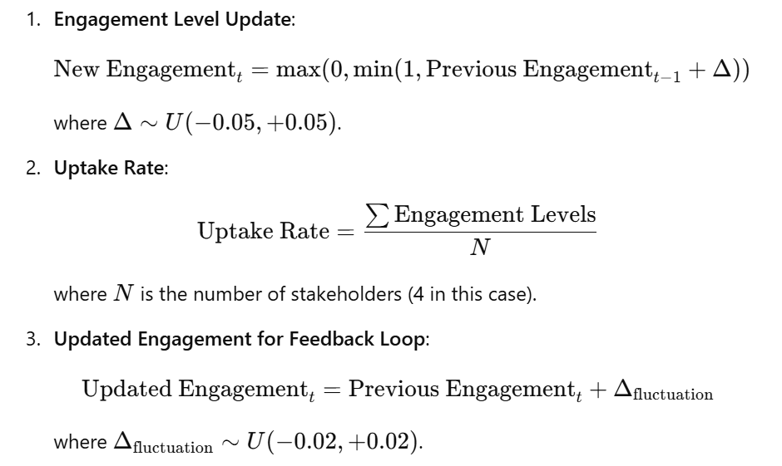
Summary of Key Formulas

Slide 33
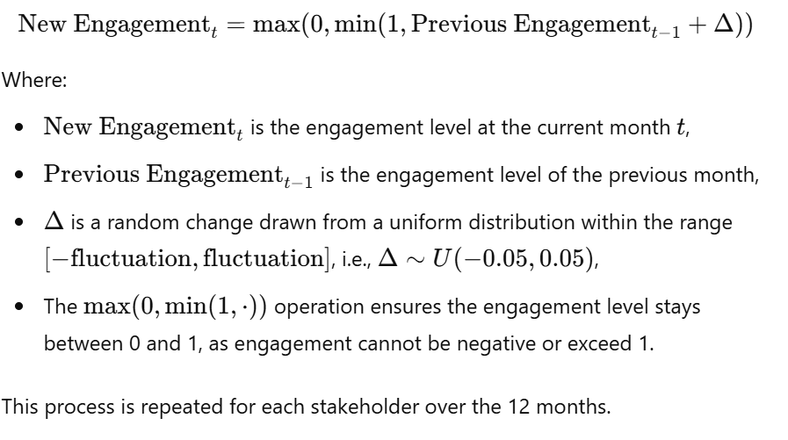
1. Engagement Simulation Formula

Slide 34
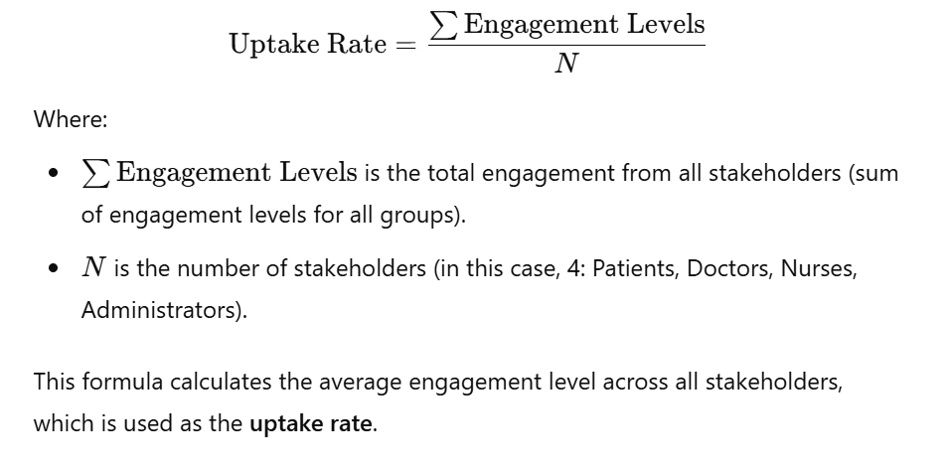
2. Model Uptake Rate Formula

Slide 35
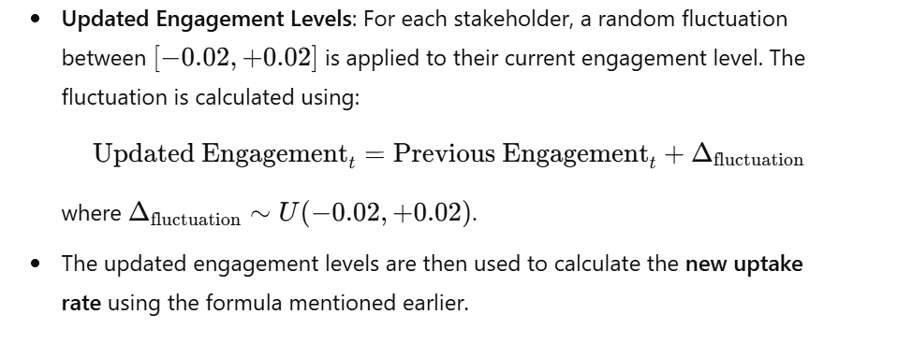
3. Uptake Rate Feedback Loop

Slide 36
Numerical Example Simulation Steps

Slide 37
Numerical example
This numerical example illustrates how:
Engagement levels fluctuate based on random changes each month.
The uptake rate is calculated as the average of the engagement levels.
A feedback loop exists, where each month's engagement influences the next, and this pattern can be visualized to see the overall trend.

Slide 38
Simulation Steps
Step 1: Define Initial Engagement Levels
Step 2: Simulate Engagement Fluctuations for 12 Months
Step 3: Calculate Uptake Rate for Month 2
Step 4: Simulate for Month 3
Step 5: Calculate Uptake Rate for Month 3
Step 6: Repeat for Remaining Months

Slide 39
Step 1: Define Initial Engagement Levels
We begin with the following initial engagement levels for each stakeholder:
Patients: 0.6 (60% engaged)
Doctors: 0.8 (80% engaged)
Nurses: 0.75 (75% engaged)
Administrators: 0.5 (50% engaged)

Slide 40
Step 2: Simulate Engagement Fluctuations for 12 Months
we apply random fluctuations (within the range [−0.05,+0.05][-0.05, +0.05][−0.05,+0.05]) each month to the initial engagement levels.
Month 1:
Initial Engagement (for all stakeholders):
Patients: 0.6
Doctors: 0.8
Nurses: 0.75
Administrators: 0.5

Slide 41
Month 2 (First Fluctuation)
Assume the random fluctuations for each stakeholder are as follows:

Slide 42
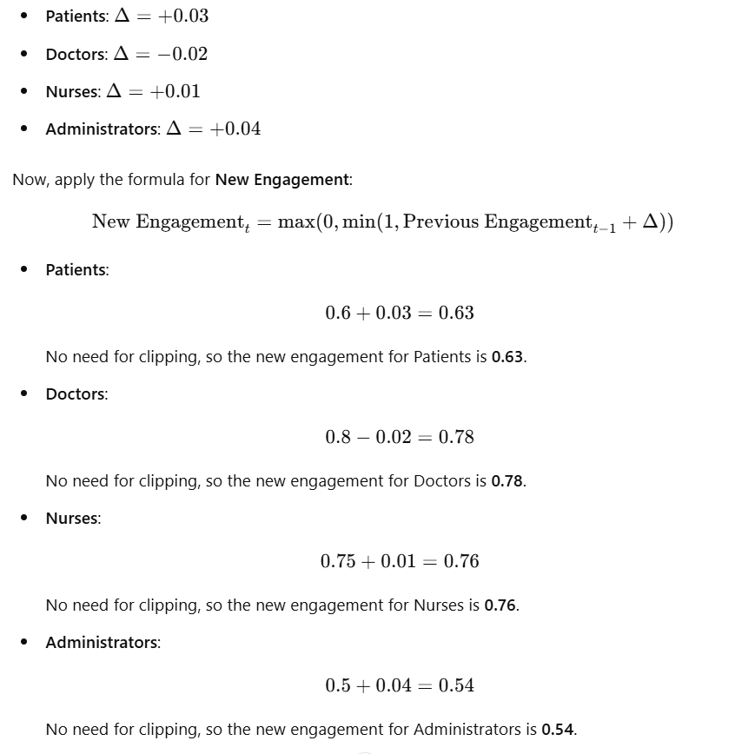

Slide 43
Month 2 Engagement Levels
Patients: 0.63
Doctors: 0.78
Nurses: 0.76
Administrators: 0.54

Slide 44
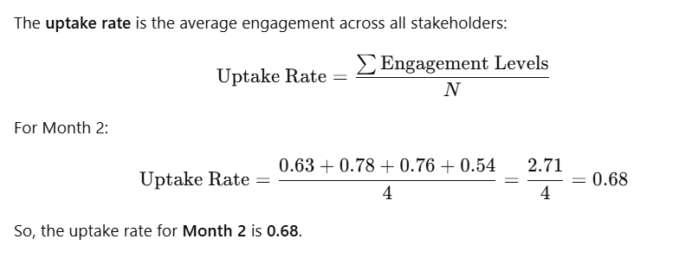
Step 3: Calculate Uptake Rate for Month 2

Slide 45
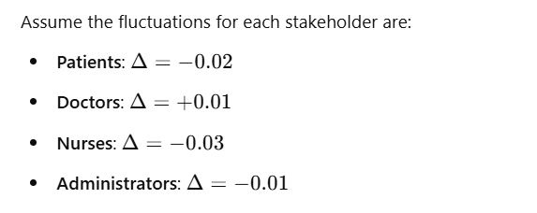
Step 4: Simulate for Month 3

Slide 46
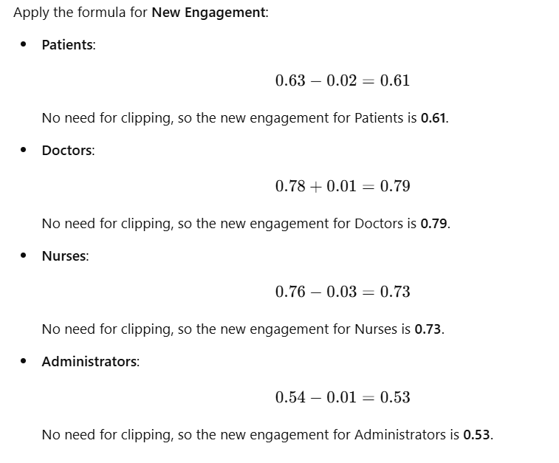

Slide 47
Month 3 Engagement Levels
Patients: 0.61
Doctors: 0.79
Nurses: 0.73
Administrators: 0.53

Slide 48
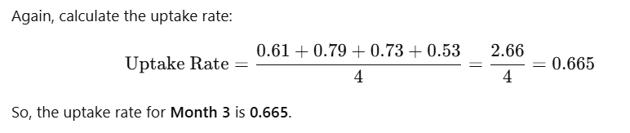
Step 5: Calculate Uptake Rate for Month 3

Slide 49
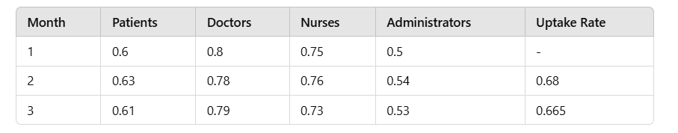
Summary of the First 3 Months

Slide 50
Step 6: Repeat for Remaining Months
The same process is repeated for the remaining months (Month 4 to Month 12), where new fluctuations are applied each month to simulate the evolution of engagement levels and the corresponding uptake rate.
The final uptakes are plotted over time to visualize the model’s performance.

Slide 51
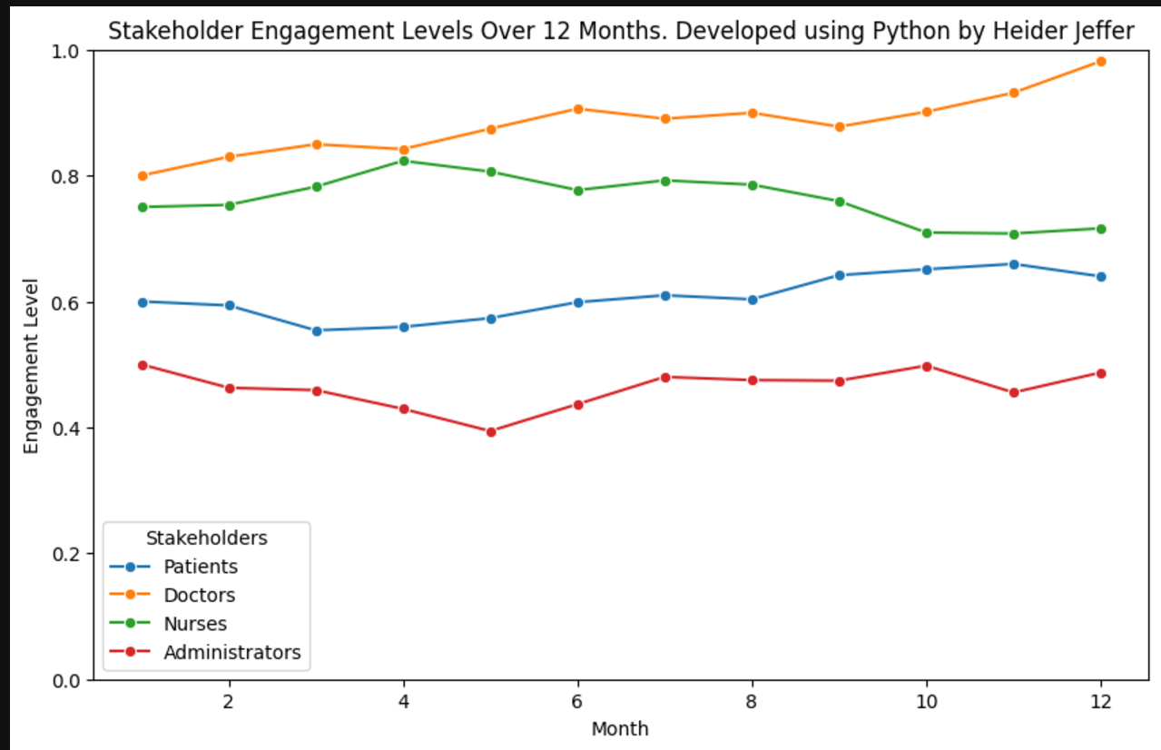

Slide 52
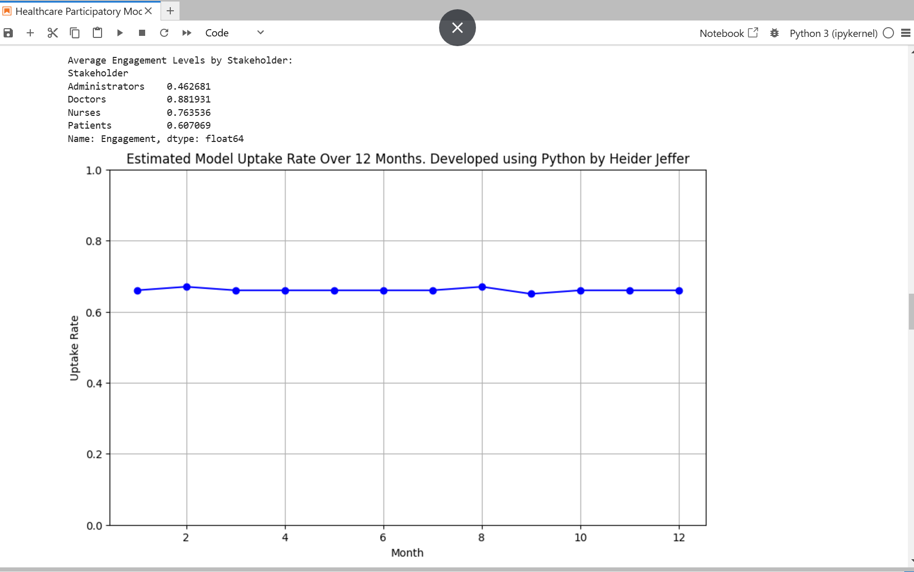

Slide 53
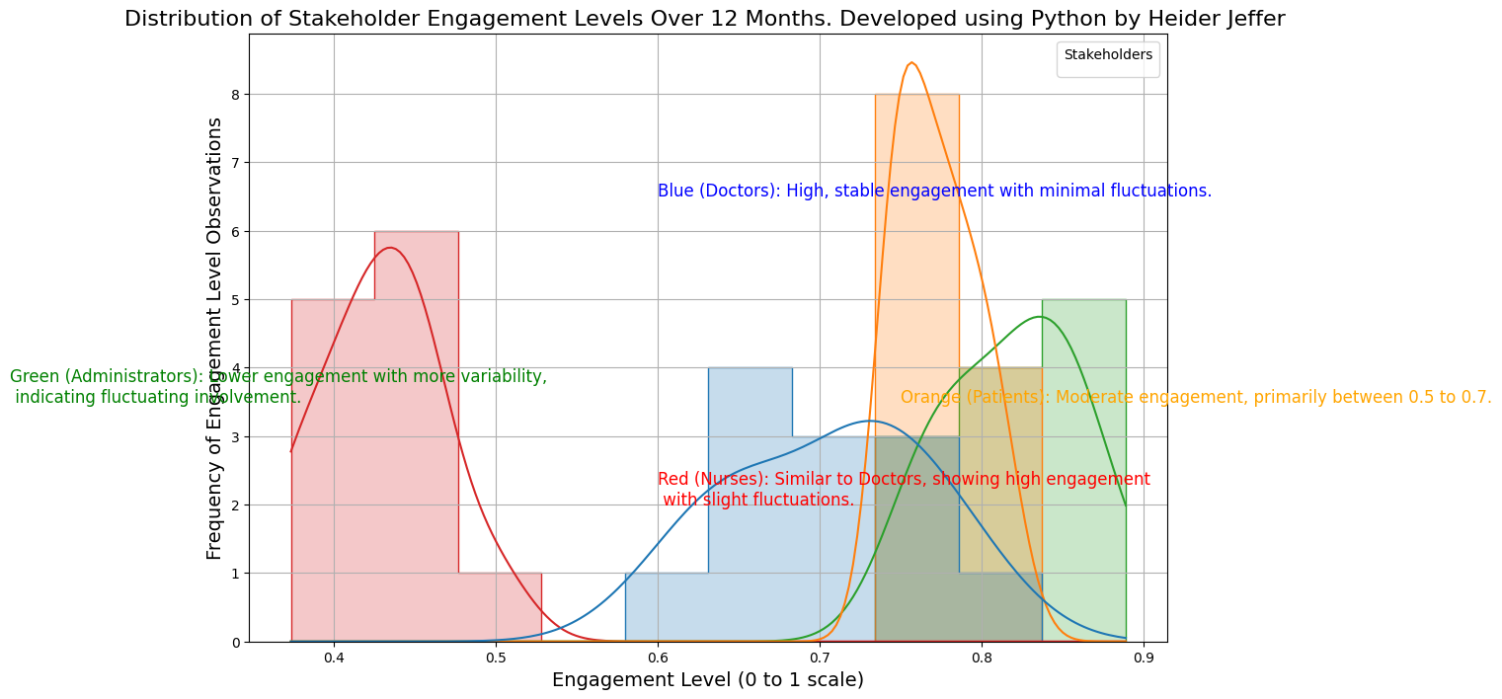
Under Development …

